Slide 1
Understanding Web Services
Madhu Venkat
Guest Faculty
BITS, WILP

Slide 2
Web Service
A Software Application
Means of Communication
Variety of Platforms
Communicate with Other Programs

Slide 3
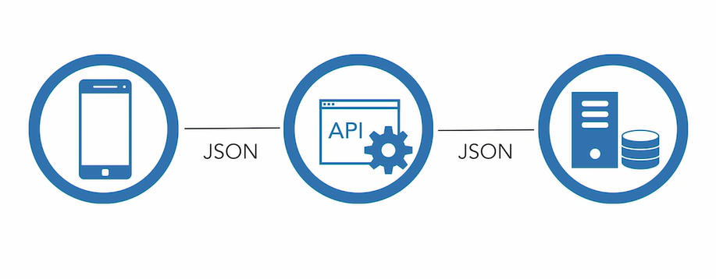
Web Service

Slide 4
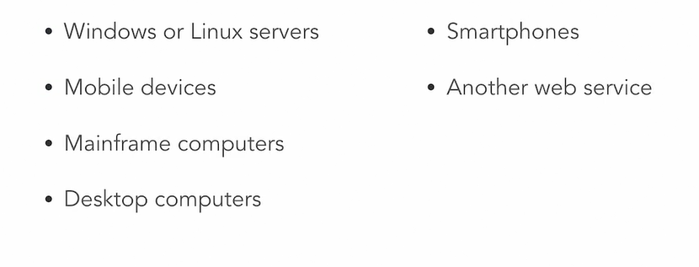
Systems

Slide 5

Communication

Slide 6
Two types of Web services
SOAP – SOAP is an XML-based web service protocol for accessing web services.
REST API – REST is an architectural style and approach to communications often used in web services development.

Slide 7
Two key entities
Provider – the device, system or organization providing the data or information
Client – the device , system requesting the data or information

Slide 8
Data exchange Formats
XML – Extensible markup language is a popular way to structure data.
JSON – Java script object notation (JSON) is a text based data interchange format derived from the Javascript language.

Slide 9
Web services provides
Language Transparency
Service provider in one language
Service client written in another
Common Language

Slide 10
Benefits
Exposes business logic and data to other systems in a secure fashion.
Provides a small reusable component that can be used by multiple systems.

Slide 11
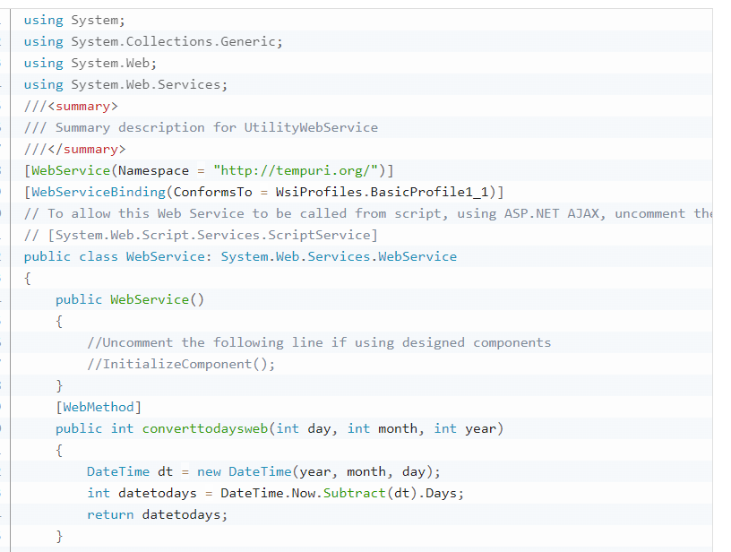
Web service example in .NET

